Slide 1
Individual-based models & Spatially explicit individual-based models with NetLogoR
21-22 Juin 2021

Slide 2
Workshop
6 sessions
Day 1 / Day 2
9h-10h30
10h45-12h
14h-16h
Is it ok that we record the workshop?

Slide 3
Goals of this workshop
Day 1
Getting familiar with individual-based models (IBMs) (1_IBMs.pptx)
Getting familiar with NetLogoR (2_NetLogoR.pptx)
Understanding simple models coded in NetLogoR (2_NetLogoR.pptx)
Day 2
Understanding more complex models coded in NetLogoR (2_NetLogoR.pptx)
Debugging IBMs (3_Debug.pptx)
Parameterizing IBMs (4_Parameter.pptx)
Publishing IBMs (5_Publish.pptx)
Coding on your own (6_Exercise.pptx)

Slide 4
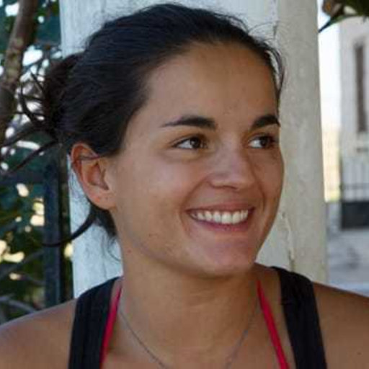
Speakers
Sarah Bauduin
Researcher in applied ecology, modeling and data analysis
Wolf-lynx team, Office Français de la Biodiversité (OFB)
sarah.bauduin@ofb.gouv.fr; https://www.sarahbauduin.fr/
Olivier Gimenez
Senior scientist in statistics, ecology and social sciences
Human-Animal Interactions group, Centre d’Écologie Fonctionnelle et Évolutive (CEFE)
olivier.gimenez@cefe.cnrs.fr; https://oliviergimenez.github.io/
Oksana Grente
PhD student in large carnivore ecology
Human-Animal Interactions group, Centre d’Écologie Fonctionnelle et Évolutive (CEFE) / Wolf-lynx team, Office Français de la Biodiversité (OFB)
oksana.grente@cefe.cnrs.fr;
Nina Santostasi
Post-doc in large carnivore ecology
Sapienza University of Rome, Italy
nina.santostasi@uniroma1.it; https://maioranolab.com/people/lab-members/ninasantostasi/

Slide 5
Present yourself!

Slide 6
Individual-based models (IBM)

Slide 7
Study examples using IBM
Estimate illegal hunting for the Lynx
https://doi.org/10.1016/j.biocon.2018.05.011

Slide 8
Study examples using IBM
Simulate dispersal patterns and estimate functional connectivity for the Delmarva fox squirrel
https://doi.org/10.1890/09-0073.1

Slide 9
Study examples using IBM
Examine the process of hybridization and introgression between the Red wolf and the coyotes
https://pubmed.ncbi.nlm.nih.gov/16922243/

Slide 10
Study examples using IBM
Simulate regional change in forest structure under different management and disturbance regimes
https://doi.org/10.1890/140327

Slide 11
Study examples using IBM
Assess the ability of potential restored landscapes to create persistent and connected populations of the federally endangered Fender’s blue butterfly
https://doi.org/10.1111/j.1365-2664.2007.01326.x

Slide 12
Study examples using IBM
Understand the effect of social structure and territoriality on canid populations
https://doi.org/10.1016/S0304-3800(03)00130-3

Slide 13
Study examples using IBM
Model the energy budget for the African elephant to relate remotely measured changes in food availability to vital demographic rates of birth and mortality
https://doi.org/10.1016/j.ecolmodel.2018.09.010

Slide 14
Study examples using IBM
Predict red fox population dynamics including responses to control and landscape productivity
https://doi.org/10.1111/1365-2664.13374

Slide 15
Study examples using IBM
Estimate the importance of different forest types and home-range fidelity in the space use of the woodland caribou
https://doi.org/10.2981/0909-6396-14.4.478

Slide 16
Study examples using IBM
Assess the vulnerability of Red-cockaded Woodpecker populations to demographic and environmental stochasticity (PVA)
https://doi.org/10.2307/3061150

Slide 17
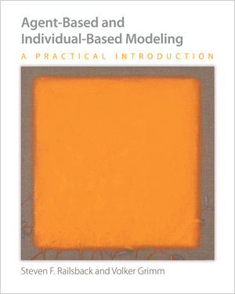
Individual-Based Models
IBMs are simulation models
Bottom-up
Rules at the individual level
Unique and autonomous entities
Interactions between individuals
Adaptive behavior
Outputs at the population level
Spatially Explicit IBMs (SE-IBMs)
Influence/Interactions with the environment
Highly mechanistic
Based on causes and effects
Understanding of the processes
Used to make predictions
Railsback and Grimm, 2012

Slide 18
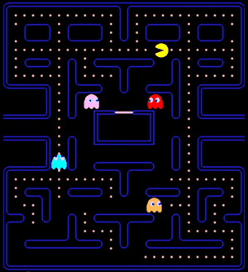
IBM example:

Slide 19
Game control = model

Slide 20
Pacman is a SE-IBM!
Repeat
Pacman
*
Habitat
MOVEMENT
Possible directions
Directions with dots
None => choose one randomly
Just one => choose this one
Several => choose one randomly
Rotate
Move
* without the ghosts

Slide 21
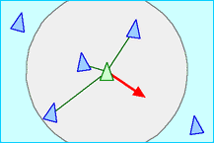
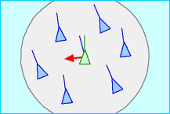
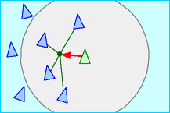
Bird flocking
Reproducing population patterns from very simple individual rules
E.g., bird flocks, fish schools
Bird flight – 3 simple rules
Separation: steer to avoid crowding local flockmates
Alignment: steer towards the average heading of local flockmates
Cohesion: steer to move toward the average position of local flockmates
Creation of bird flock
Reynolds, 1986

Slide 23
References
Individual-based models
Grimm V, Railsback SF. 2005. Individual-based modeling and ecology. Princeton University Press, Princeton, NJ.
Railsback SF, Grimm V. 2012. Agent-based and individual-based modeling: a practical introduction. Princeton University Press, Princeton, NJ.
Reynolds. 1986. https://www.red3d.com/cwr/boids/
Bauduin S, Grente O, Santostasi NL, Ciucci P, Duchamp C, Gimenez O. 2020. An individual-based model to explore the impacts of lesser-known social dynamics on wolf populations. Ecological Modelling 433:109209.
van Vliet K, Hofstede GJ. 2019. Wolves ODD.

